Slide 1
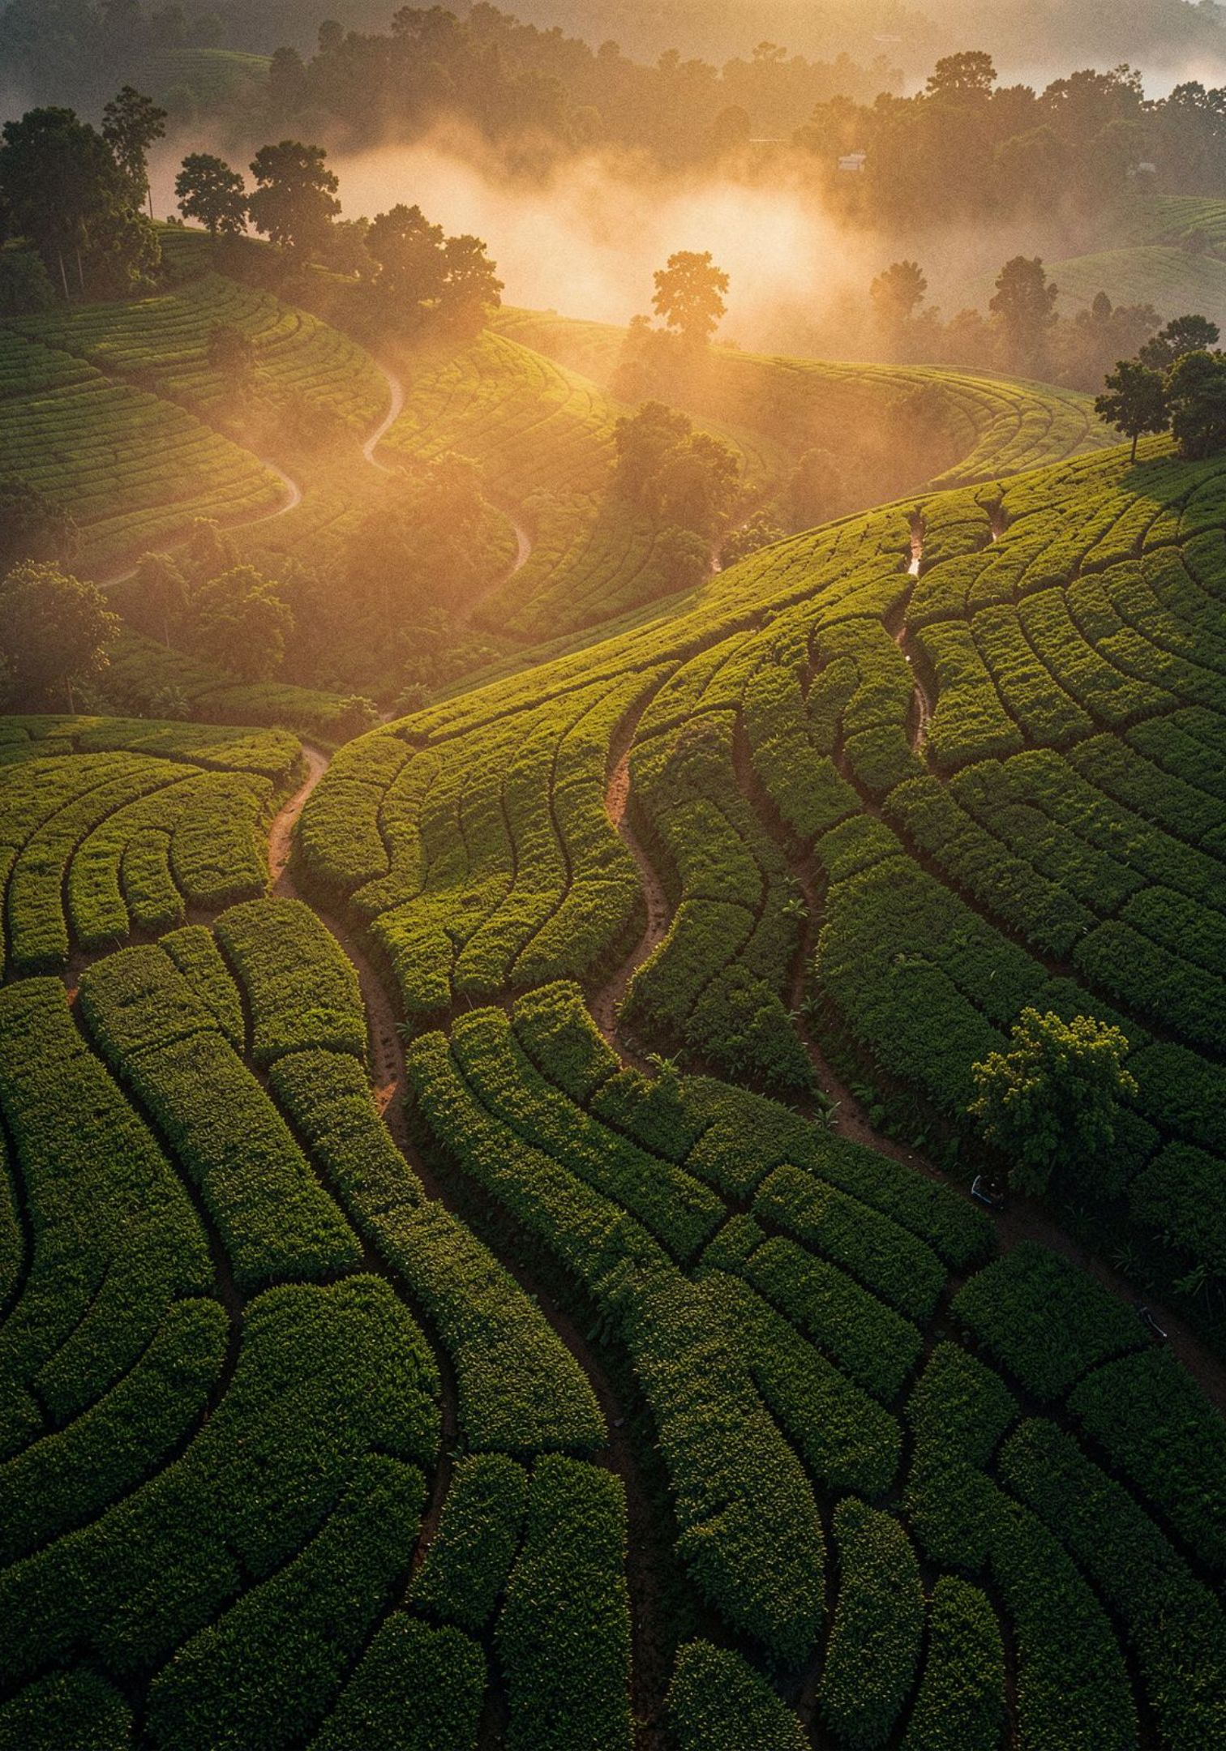
TRIPLY
Personalized Travel Discovery Platform
"You tell us what you want, Triply tells you where to go."
Bangladesh-focused personalized travel discovery and recommendation platform

Slide 2

The Problem
How People Travel Today
Two Different Models
Don't know where to go
Traditional platforms fail them
Traditional Travel
Triply Approach
Destination → Information
You already know where you want to go.
Situation → Preferences → Recommendation → Destination
The destination finds you.
People want to travel but lack a starting point — different budgets, time constraints, moods, and starting locations make it overwhelming.
Existing travel sites require you to already know your destination. They answer "How?" — not "Where?" or "What kind?"

Slide 3

Introducing Triply
Triply is a personalized travel discovery platform that reverses the traditional travel search model — matching your situation with the perfect destination.
Situation-First
Smart Matching
Tell us your mood, budget, and time — not a destination name.
The engine analyzes your preferences and finds best-fit destinations.
Discover Bangladesh
Uncover hidden gems and popular spots across Bangladesh tailored to you.
"Don't search for a destination. Let the destination find you."

Slide 4
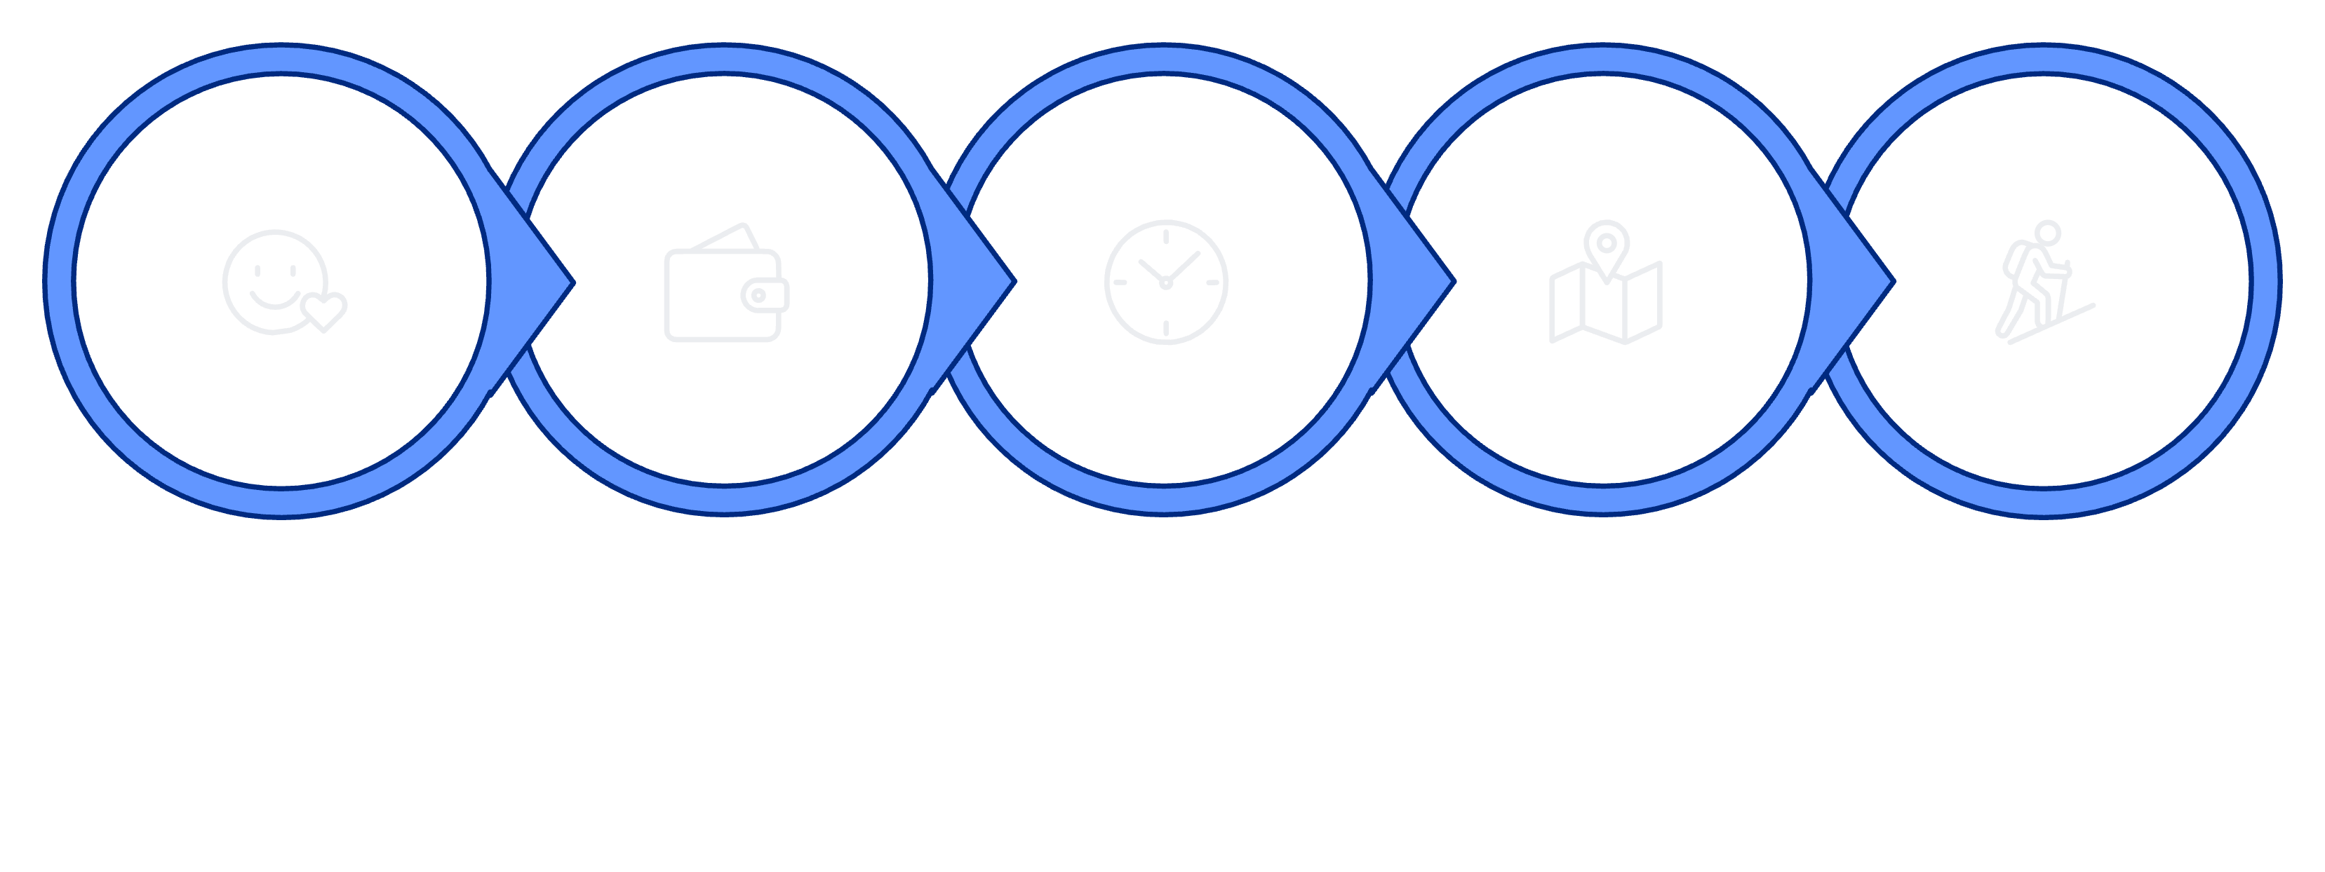
How Triply Works
Situation
Budget
Duration
Start
Activities
From your first input to your perfect destination — Triply's recommendation engine processes all five user parameters simultaneously to surface the most relevant matches across Bangladesh.

Slide 5





Travel Based on Your Situation
Every kind of traveler. Every kind of trip.
Users describe the trip they want — not the destination they already know.
Peaceful & Nature
Adventure & Active
Getaways, nature escapes, photography, relaxation
Hiking, trekking, adventure travel, one-day trips
Social & Cultural
Budget & Solo
Family trips, couple getaways, food tours, cultural exploration
Solo trips, budget travel, weekend escapes

Slide 6

What Does Triply Ask?
"What kind of trip do you want?"
Five simple inputs. One perfect destination.
01
Rather than confronting users with an overwhelming map or destination list, Triply starts a conversation. You describe your ideal trip — your mood, your wallet, your calendar, your city, your passions.
The engine handles the rest. One tap on → Find My Destination submits all parameters to the recommendation logic and surfaces your best matches instantly.
Situation
Peaceful Nature Trip
02
No destination knowledge required. Triply is designed for travelers who are inspired but undecided.
Budget
৳3,000 – ৳5,000
03
Duration
2 Days
04
Starting Location
Dhaka
05
Activities
Photography + Nature

Slide 7
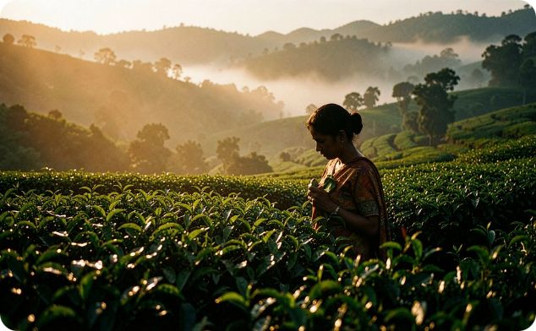
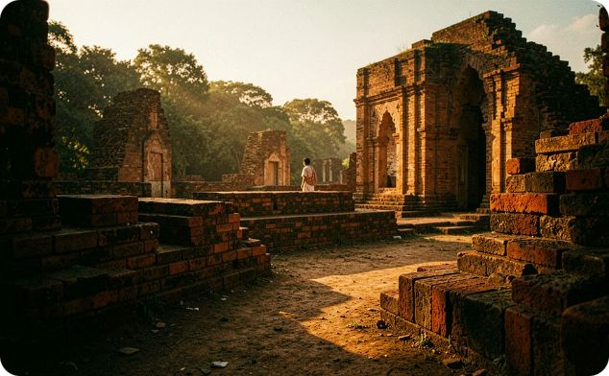
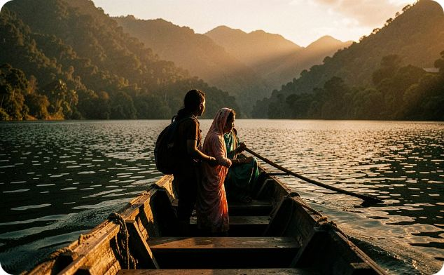
Smart Destination Recommendations
94% Match — Sreemangal
88% Match — Sonargaon
82% Match — Rangamati
Tea gardens, hiking trails, and lush photography landscapes. Ideal peaceful nature escape from Dhaka.
Cultural heritage, scenic nature, and budget-friendly options — perfect for a short cultural day trip.
Mountain scenery, adventure activities, and breathtaking lake views for the more adventurous traveler.
Each recommendation surfaces a destination image, match score, estimated budget, duration, and activity tags — everything needed to decide at a glance.

Slide 8
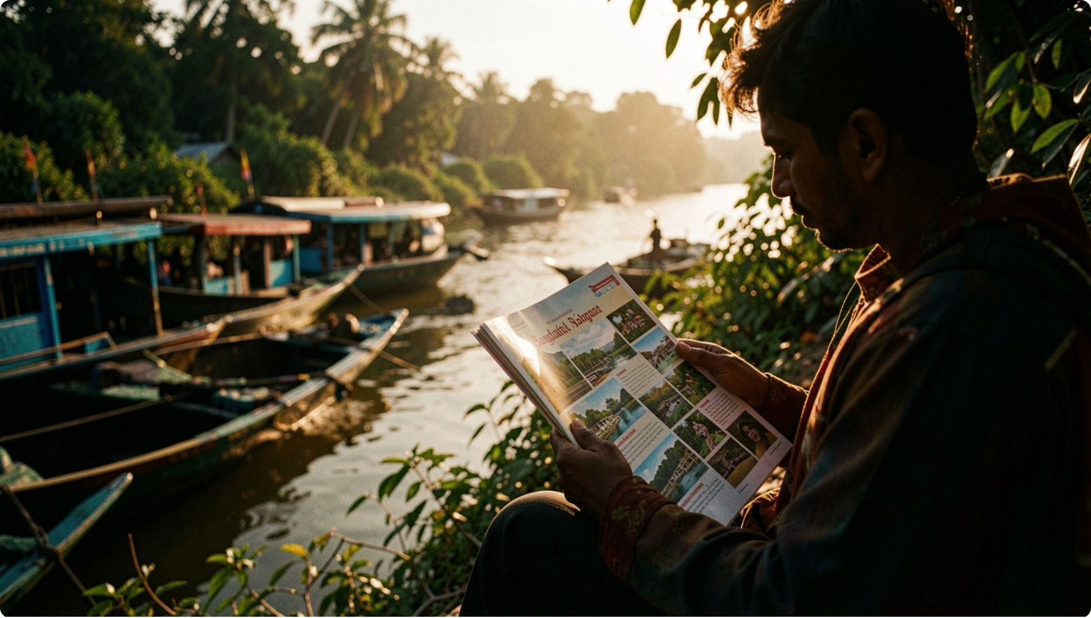
Explore Before You Go
Detailed destination pages for informed decisions
Overview & Visuals
Destination images, location map, and a rich summary of what makes the place special.
Practical Details
Estimated budget, recommended duration, best time to visit, and current weather information.
Activities & Insights
Available activities, nearby attractions, travel tips, and local insights from the community.

Slide 9





Technology Stack
Current Version — Built to Work
HTML5
CSS3
JavaScript
Font Awesome & Google Fonts
Website structure and semantic markup
Responsive design and modern UI styling
Recommendation logic and interactivity
Icons and consistent typography

Slide 10
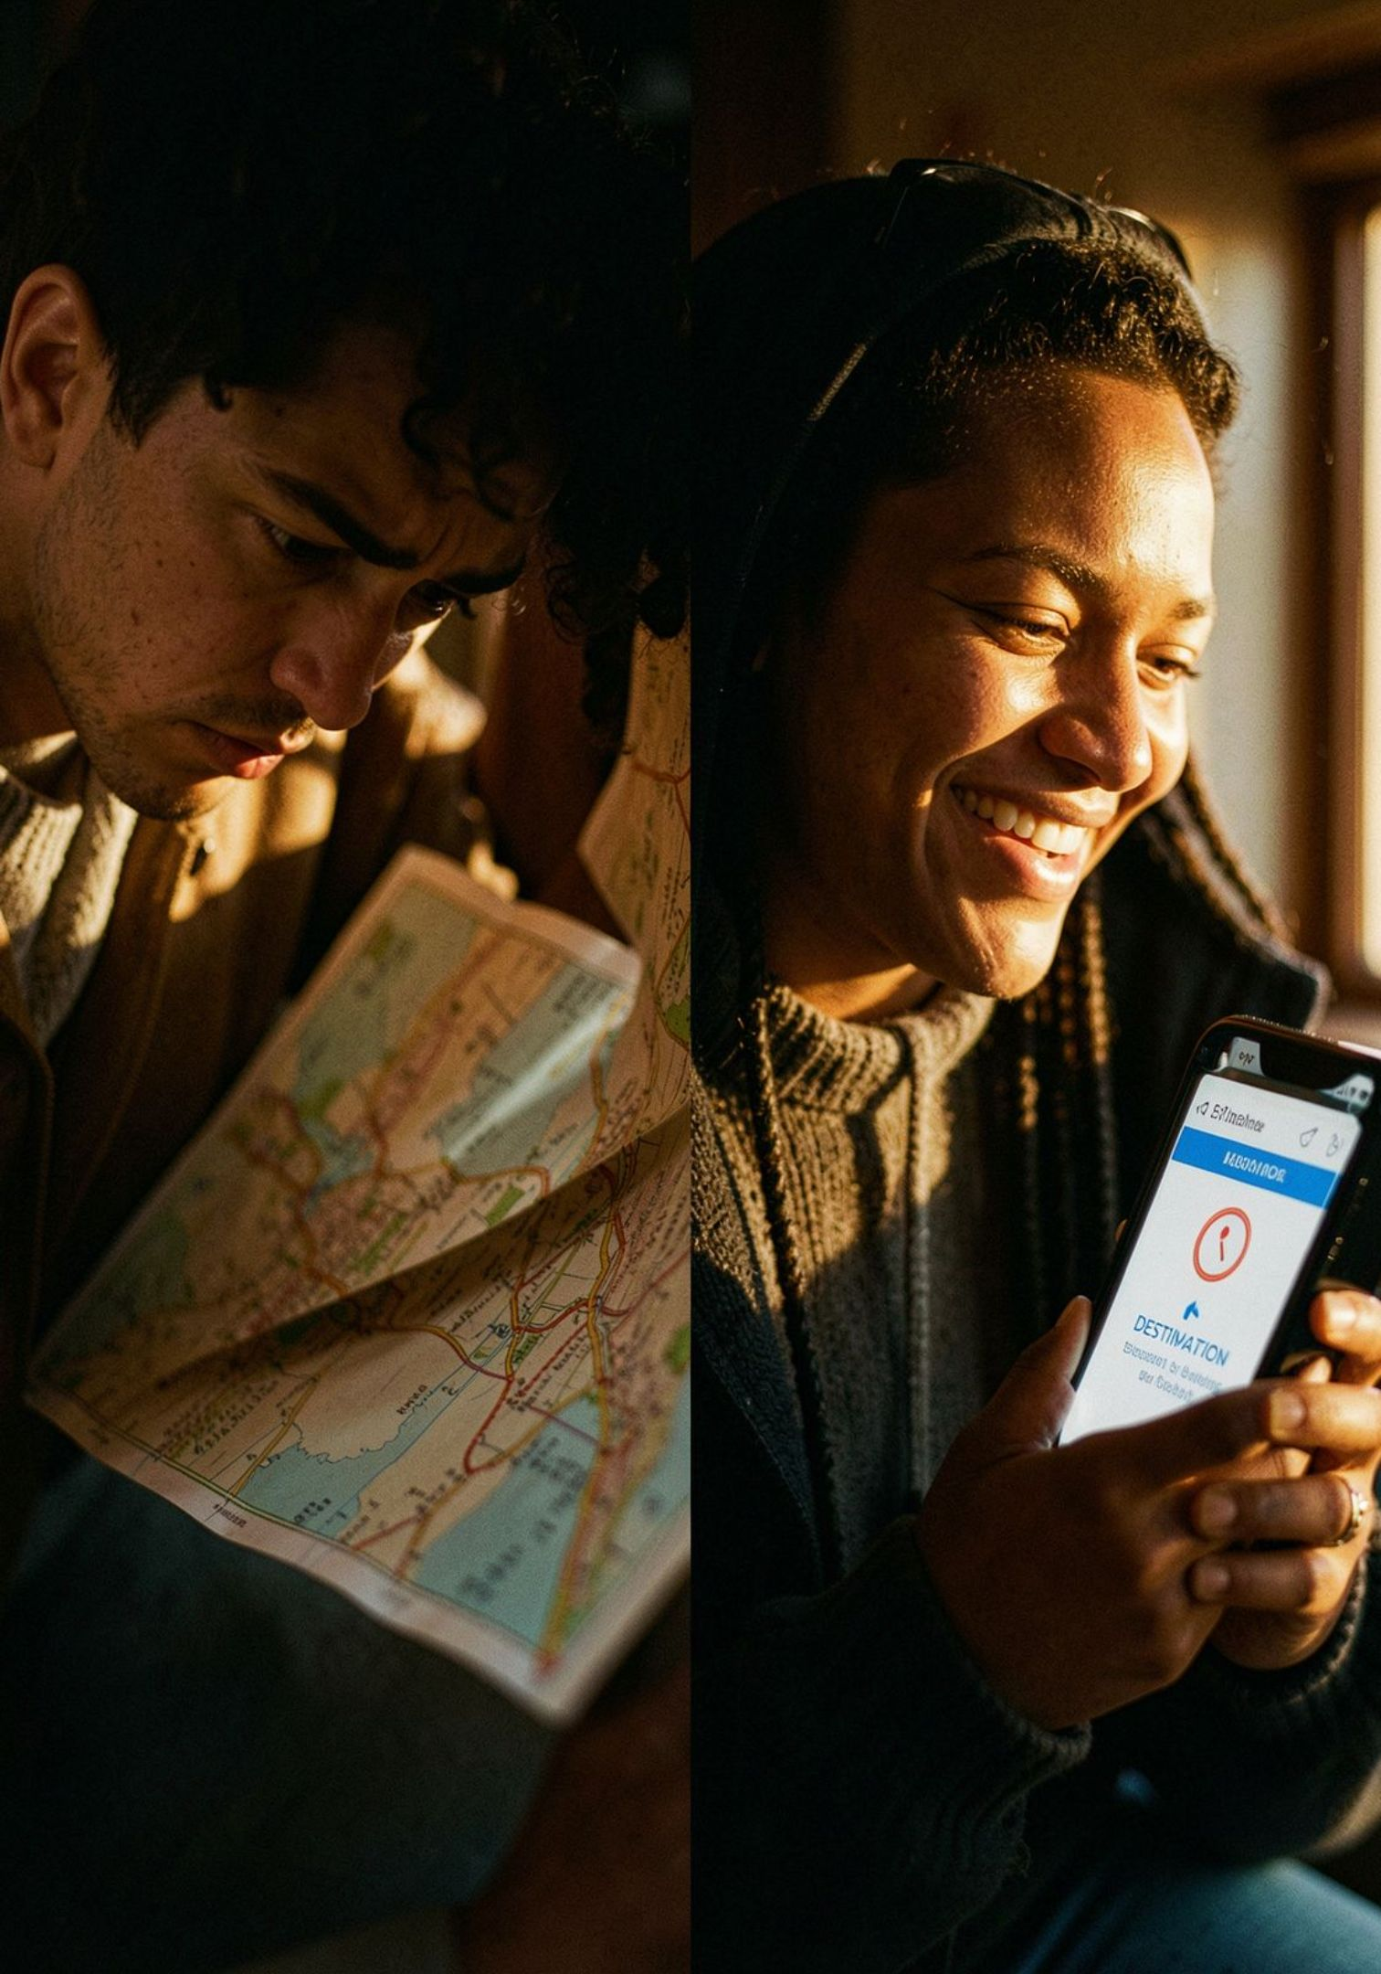

Why Triply?
The Core Innovation: Reverse Travel-Search
Traditional Platforms Ask "Where?"
Destination-first. Requires prior knowledge. Leaves undecided travelers with no guidance.
Triply Asks "What Kind of Trip?"
Situation-first. Personalized, budget-aware, time-aware, and activity-based recommendations for Bangladesh destinations.

Slide 11




Target Users
Students & Youth
Families & Couples
Solo & Photography
Adventure & Budget
University students and groups of friends seeking affordable, exciting weekend escapes on a tight budget.
Families planning quality time together and couples looking for meaningful, memorable getaway experiences.
Independent explorers and photography enthusiasts discovering Bangladesh's hidden natural and cultural gems.
Adventure travelers and budget-conscious domestic tourists who want more from every trip without overspending.
Triply is for anyone who wants to travel — but is unsure where to go.

